Slide 1
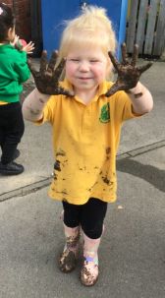
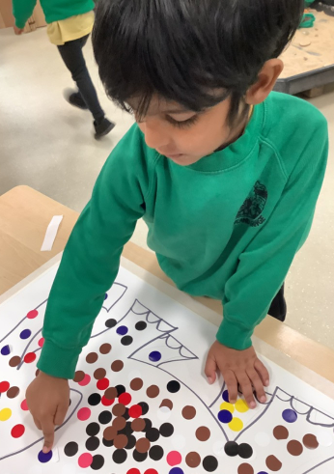
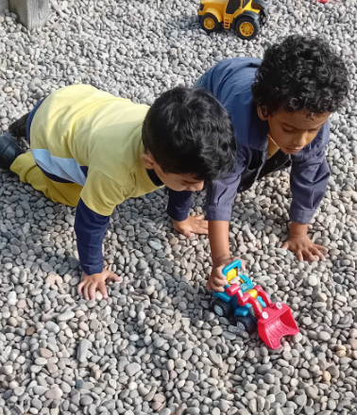
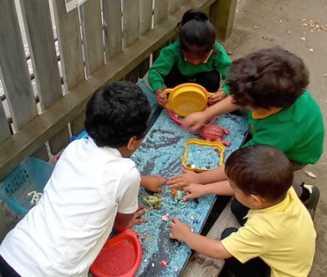
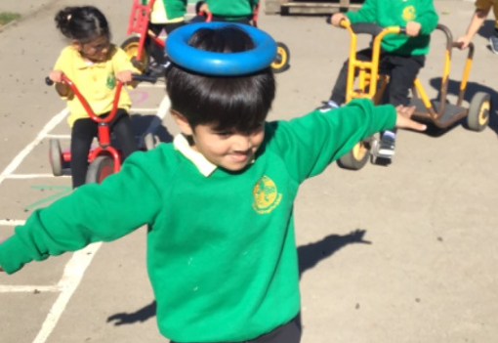
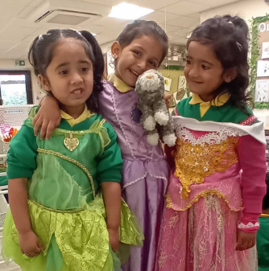
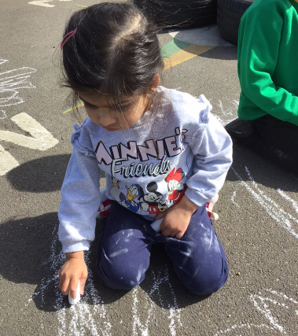
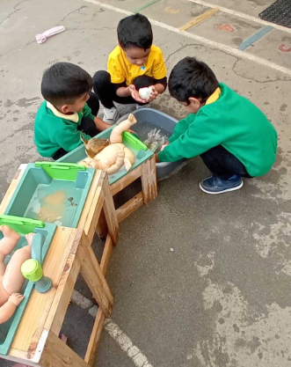
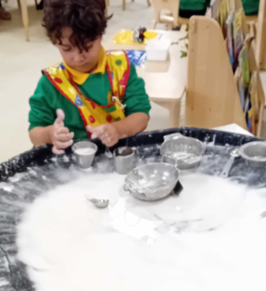
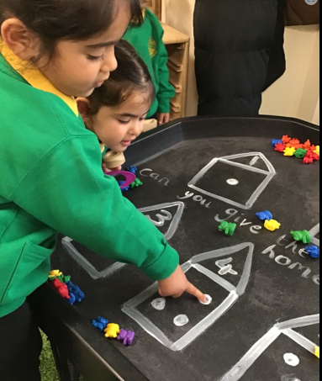
Welcome to Pre-School
Curriculum Evening 2024

Slide 2
Ensuring a child feels valued and that you are invested in them.
Knowing the children and families!
Communication with families
We move children on by being involved in their play and reflecting on the things that they say and the actions they are taking.
We don’t spend the whole time assessing as our knowledge of the children is far greater than tick list after tick list.
TALK is vital in the development of ALL children!
Building Relationships in Early Years is the key to development!
RELATIONSHIPS

Slide 3
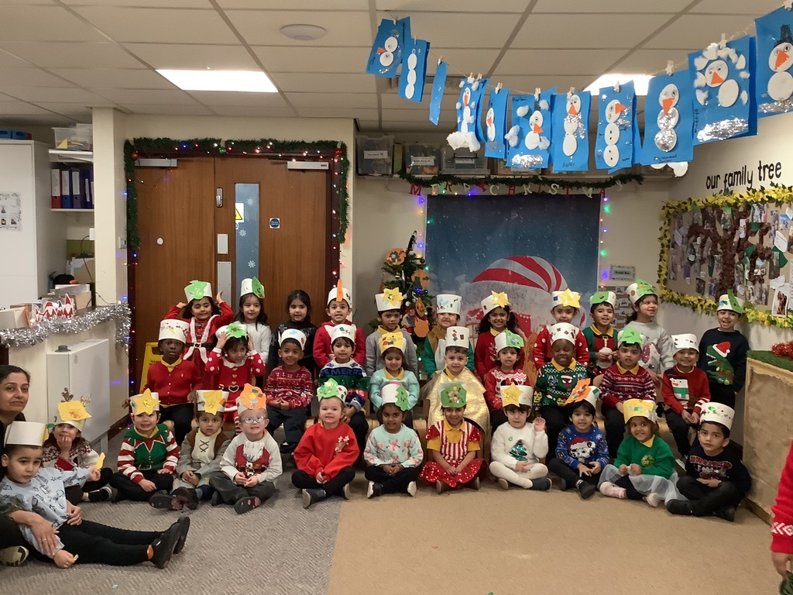
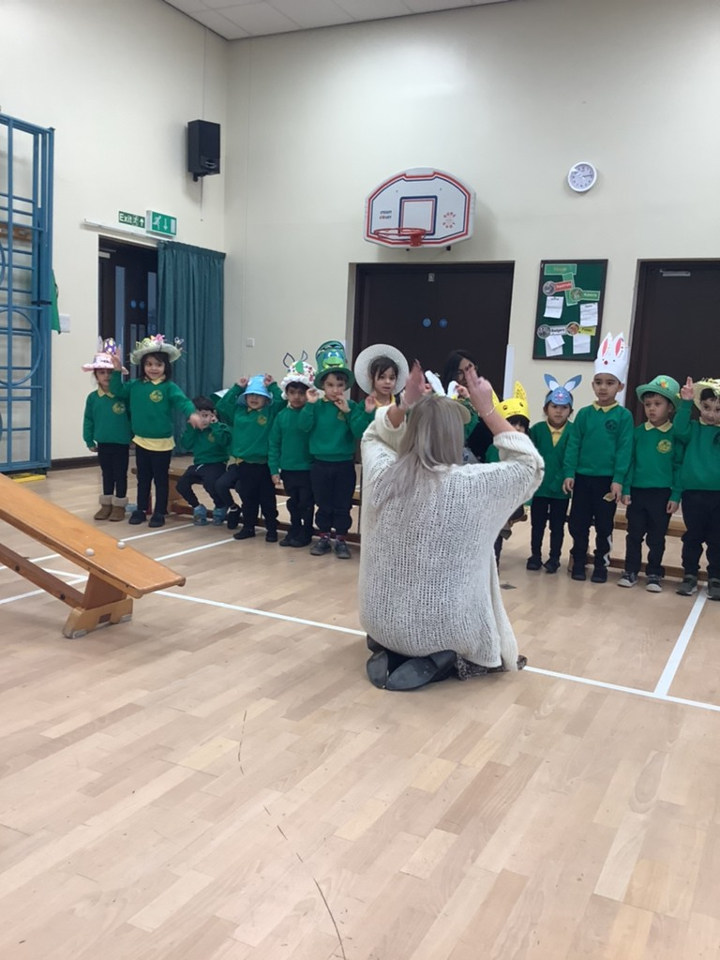
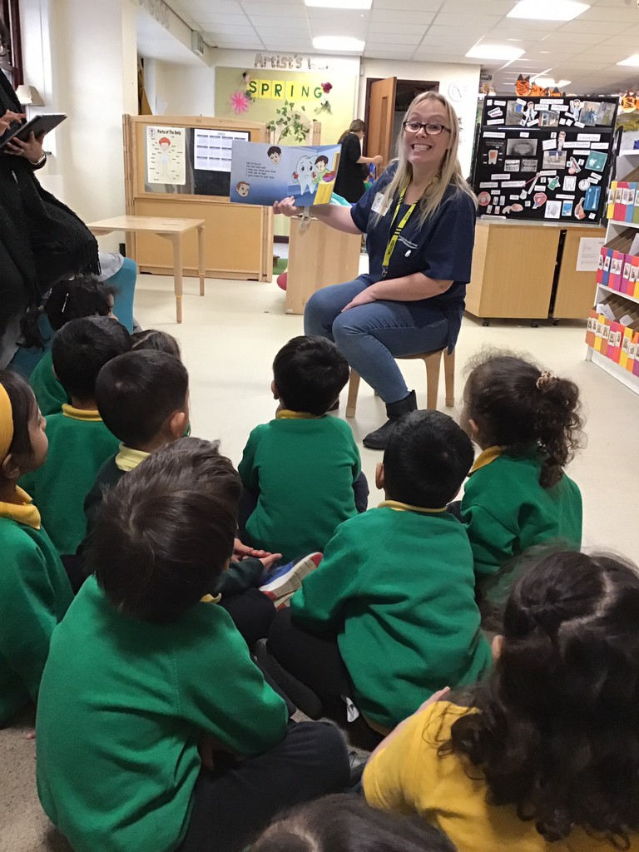
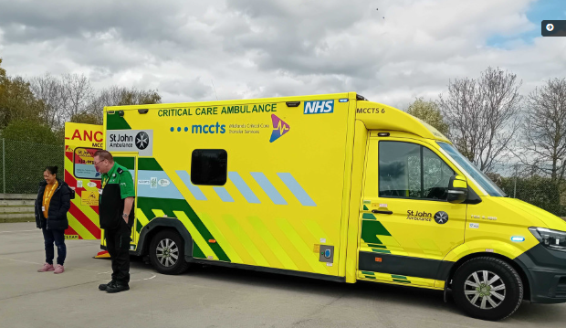
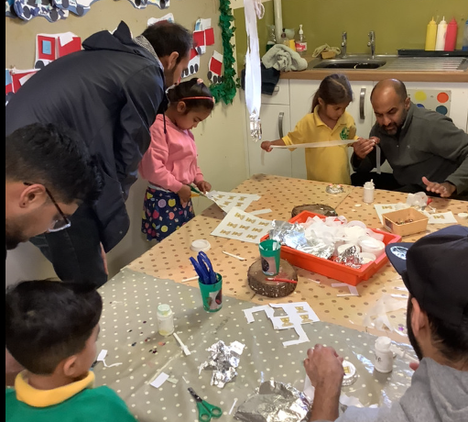
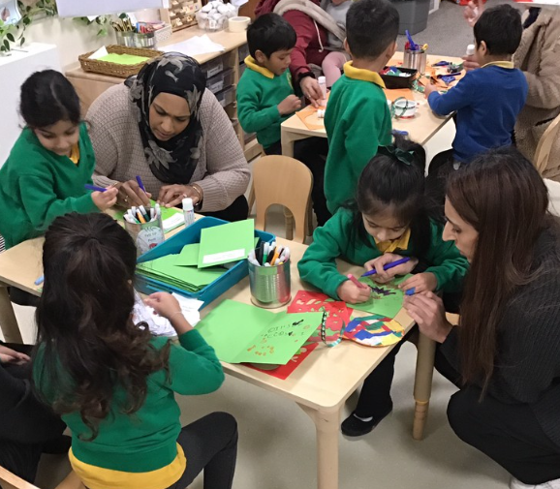
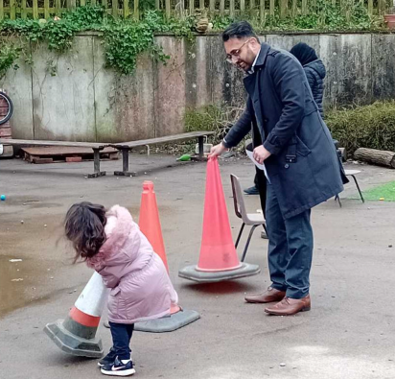
Family involvement
A visit from a parent dentist
A visit from a parent paramedic
Christmas concert
Easter parade
Father’s day afternoon
Easter egg hunt
Decorations Day

Slide 4



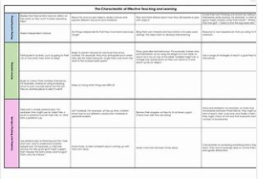

PORTFOLIO
Samantha Brewster

Slide 5
Seven Areas of Learning
COMMUNICATION & LANGUAGE
LITERACY
Listening, understanding and speaking.
Comprehension, word reading, writing.
specific areas
prime areas
PERSONAL, SOCIAL & EMOTIONAL
MATHS
Self-regulation, manging self and building relationships
Number, Numerical patterns
UNDERSTANDING THE WORLD
PHYSICAL DEVELOPMENT
Past & present; People, culture & communities; The Natural World
Fine and gross motor skills.
EXPRESSIVE ARTS & DESIGN
Creating with materials; Being imaginative and expressive.
The prime areas are fundamental in a child’s life and underpin all other areas of learning and development.
All areas are interconnected.

Slide 6
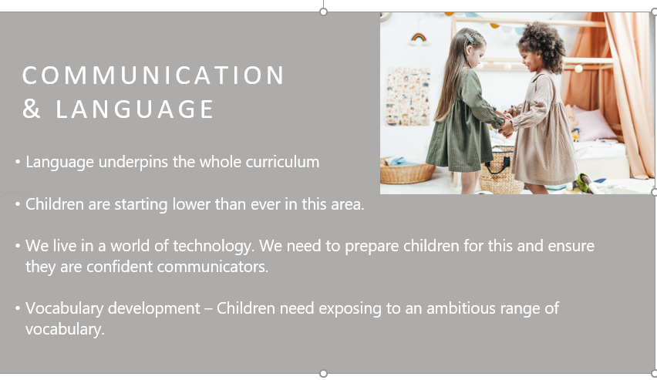
Communication and language (C&L)
Communication and language
Is split into 3 parts:
Listening and attention
Understanding
Speaking

Slide 7
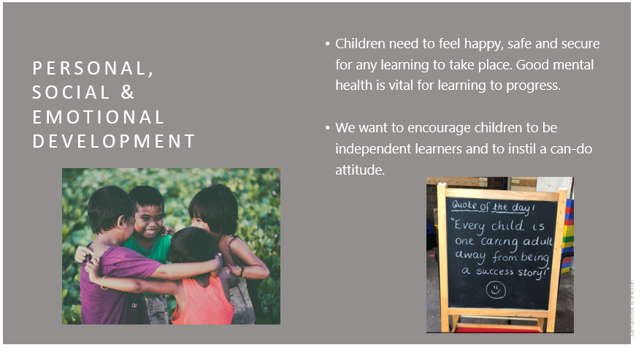
Personal, social, emotional development (PSED)

Slide 8
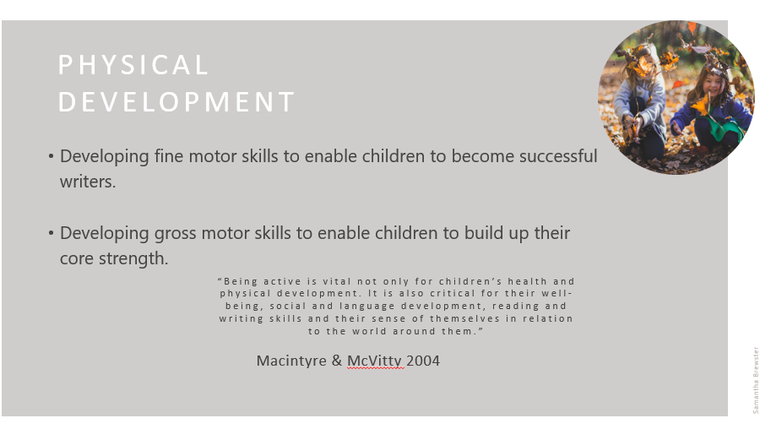
Physical development (PD)

Slide 9
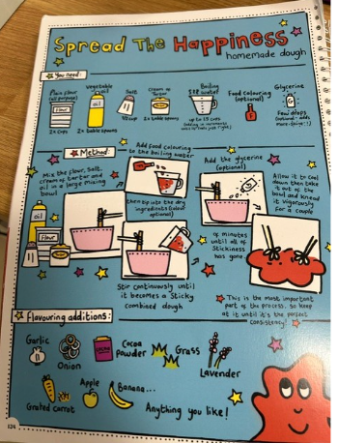
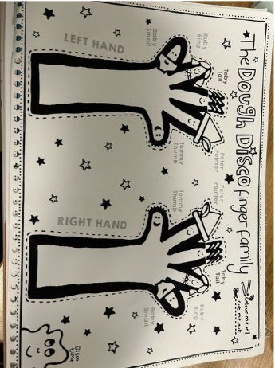
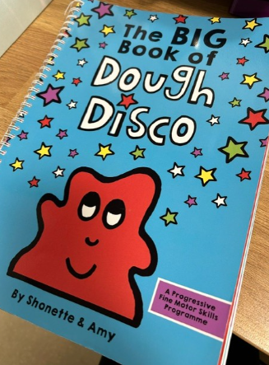
How we develop physical skills in Pre-school
Dough Disco

Slide 10
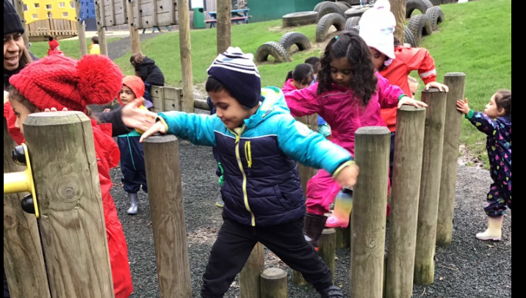
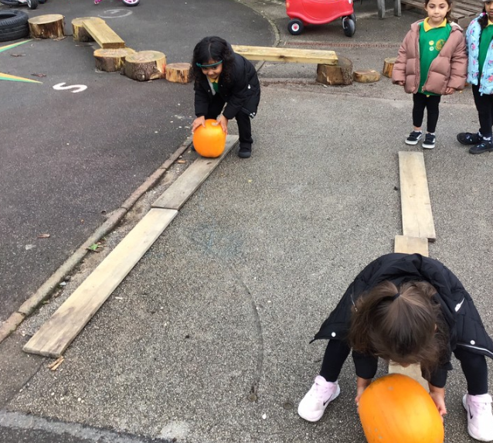
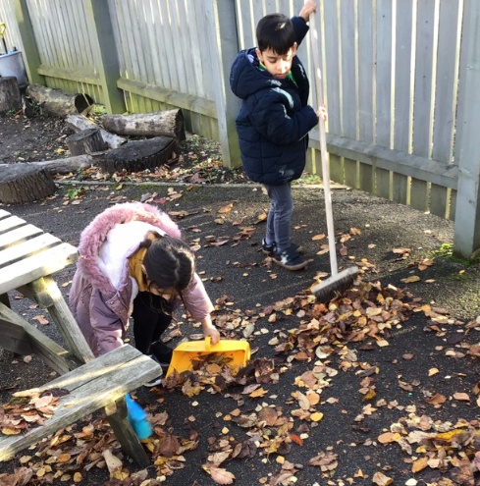
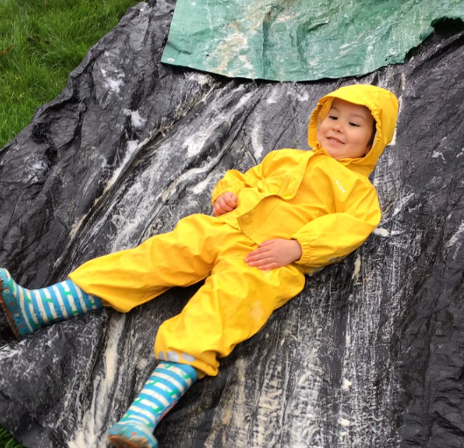
Gross motor activities

Slide 11
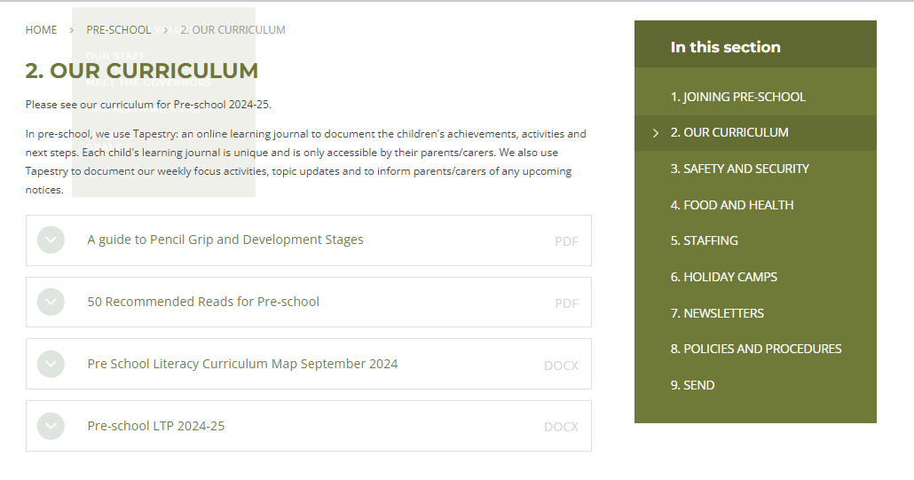
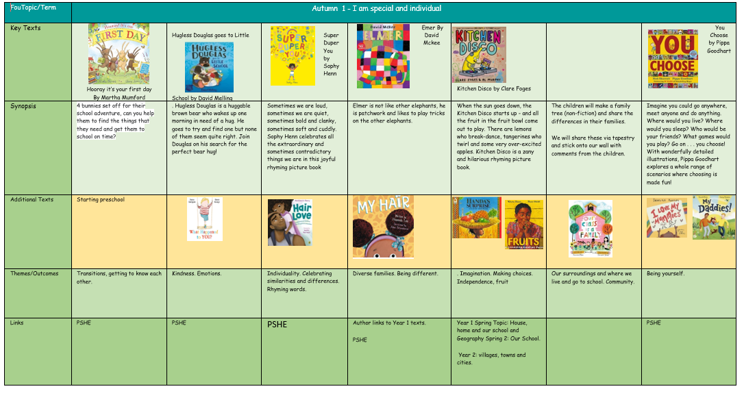
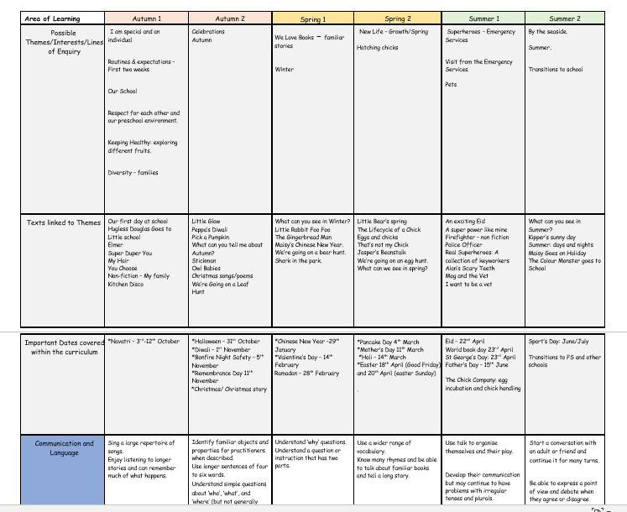
Our Curriculum
Story- based
Celebrations/ occasions

Slide 12
How does my child learn at preschool?
Carpet sessions
Focused activities
Group work
Next steps
Continuous provision

Slide 13
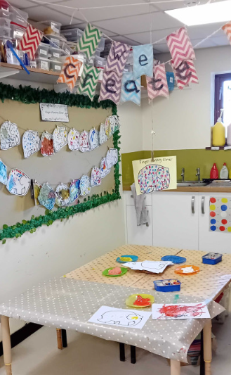
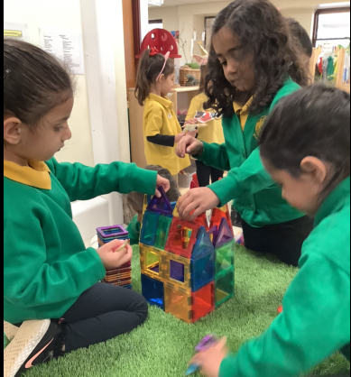
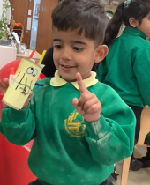
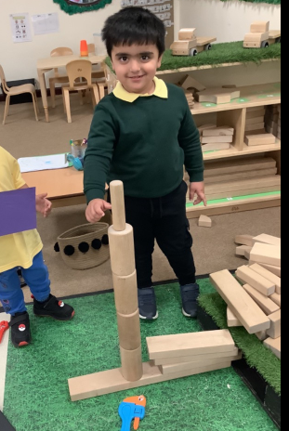
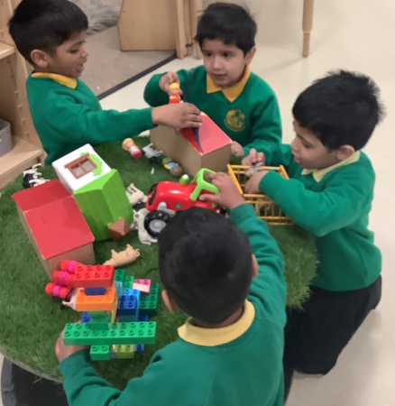
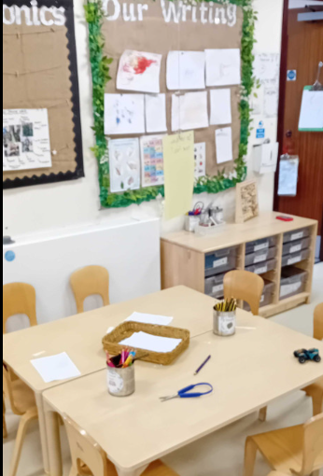
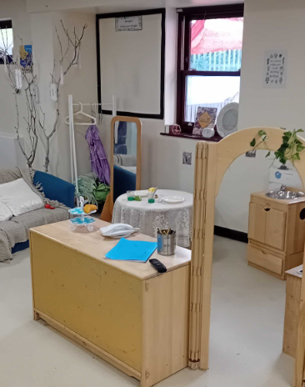
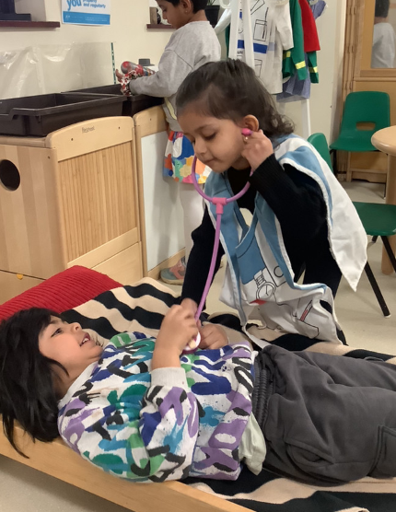
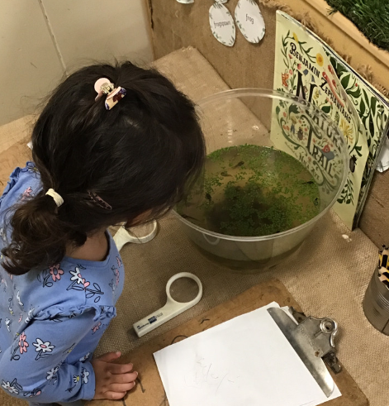
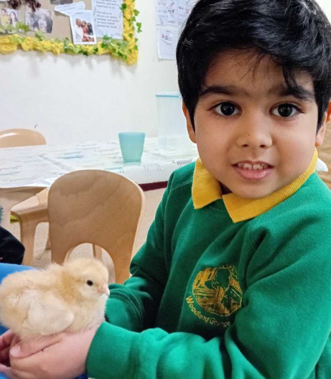
Zones in the classroom
Building and construction area
Creative area
Small world area
Role-play area
Investigation area
Writing area

Slide 14
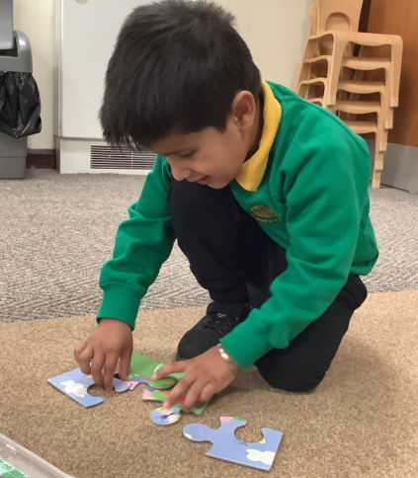
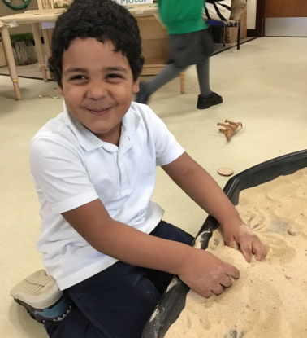
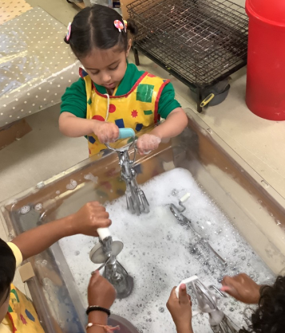
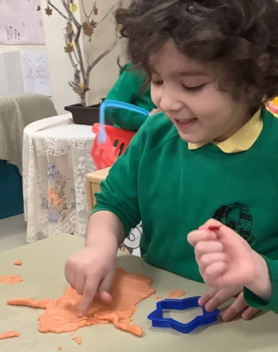
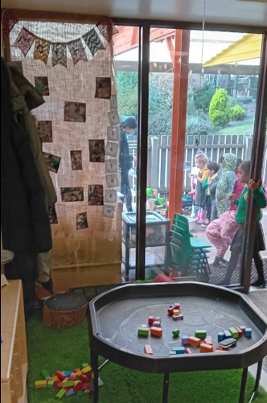
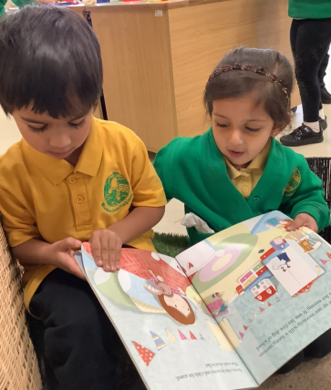
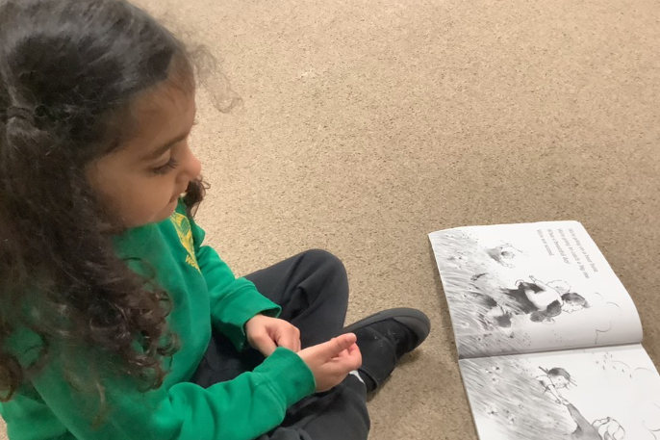
Zones in the classroom
Jigsaw station
Sand area
Water area
Malleable area
Cosy corner and book area
Maths area

Slide 15
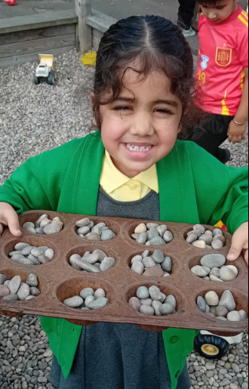
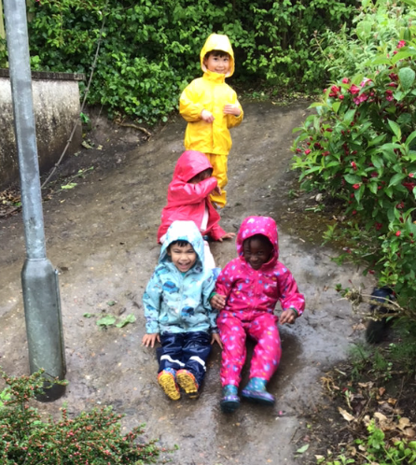





Outdoors

Slide 16






Exploring Nature sessions

Slide 17

How can I help my child at home?

Slide 18

How can I help my child at home?

Slide 19

How can I help my child at home?

Slide 20


Snack table and lunch time
Independence
Use of cutlery
Posting name

Slide 21

Tapestry
A place to celebrate your child!
Other uses:
Memos
Newsletters

Slide 22


Lending library
Story sacks

Slide 23

AOB
Invoices: Mrs Mistry in the main school office
Holiday camps: Miss Motiwaras
                Upcoming dates
Newsletters
Welcome board
Availability for extra hours

Slide 24


Tell me and I’ll forget. Teach me and I’ll remember. Involve me and I’ll learn.
- Benjamin Franklin

